Slide 1
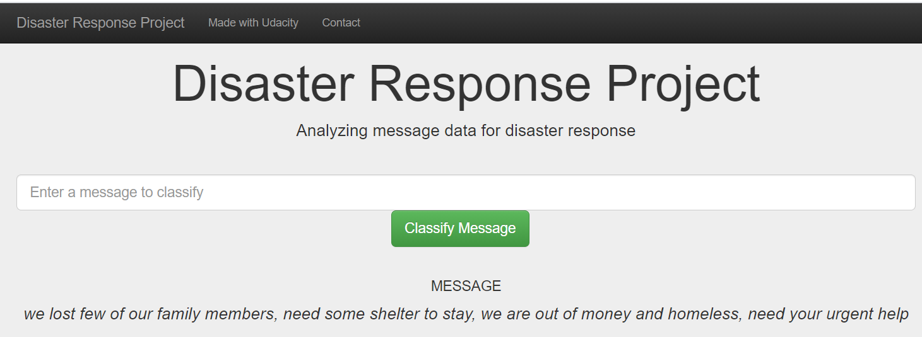
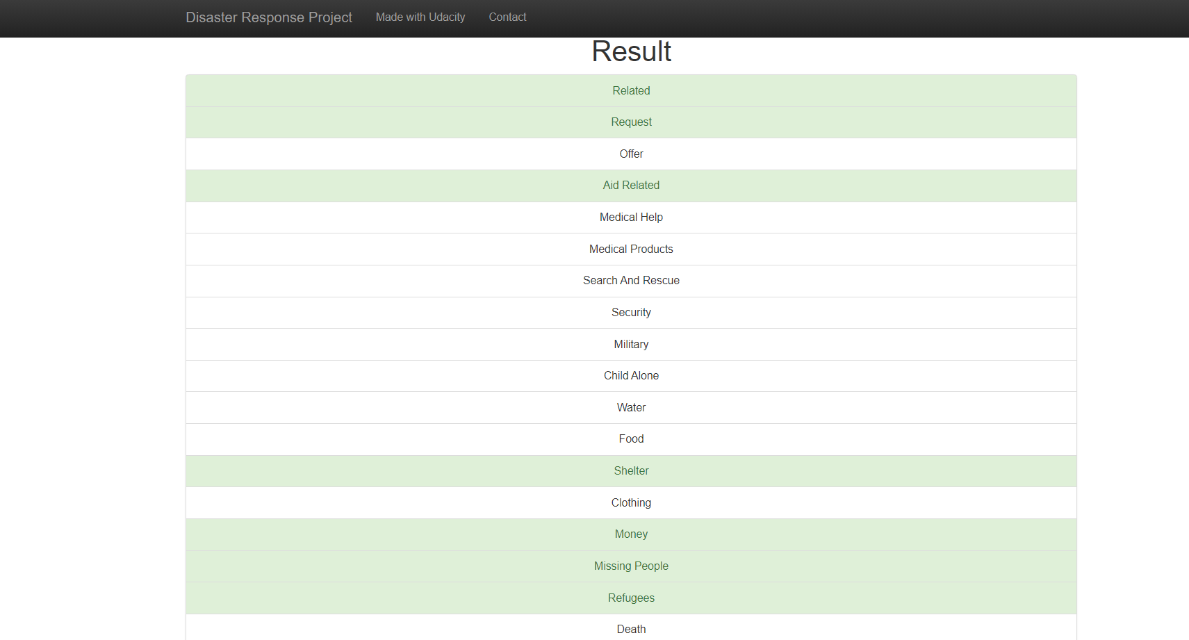
Input Message-1
Input text message in the text box and then click on the classify message button.
The ML model will then classify the input message to various categories and display the categories under Result section as shown in the picture here.

Slide 2
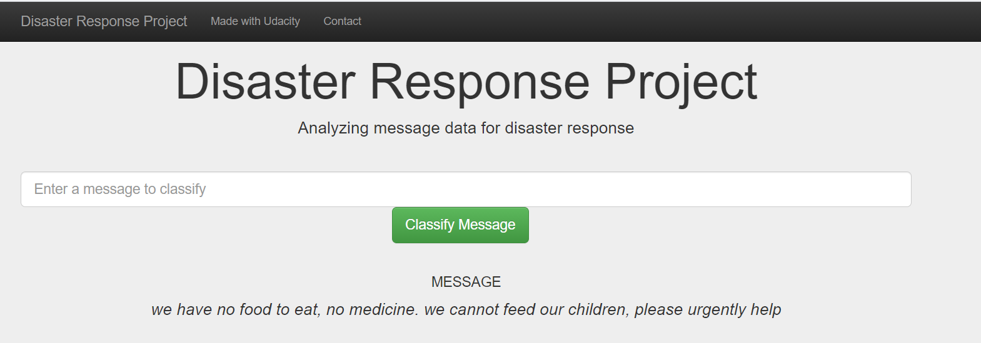
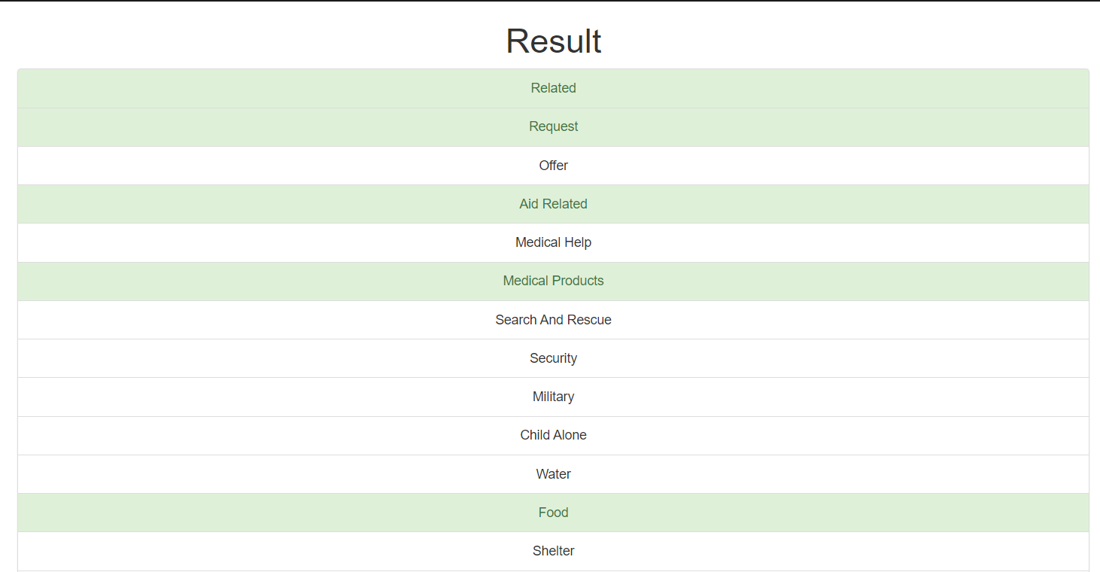
Input Message-2
Input text message in the text box and then click on the classify message button.
The ML model will then classify the input message to various categories and display the categories under Result section as shown in the picture here.

